Slide 1
MGS 723: Geodynamics
Class 26: Convection II
Main references for today: Turcotte and Schubert textbook (Ch. 6)
Mulyukova and Bercovici, 2020

Slide 2


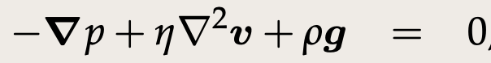
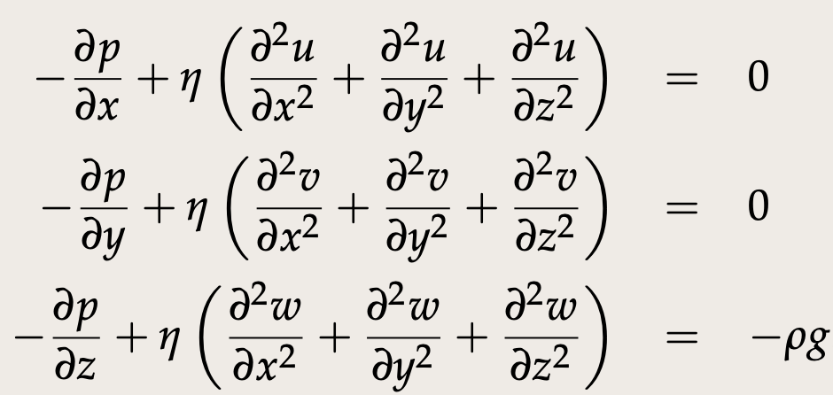
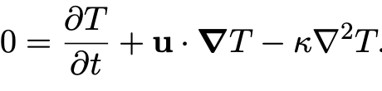
Conservation
of mass
Conservation
of momentum
Vector form:
In full (Cartesian):
convection
Conservation
of energy
Notes:
https://www3.nd.edu/~cneal/PlanetEarth/Chapt-11a-Rock-Mechanics.pdf

Slide 3
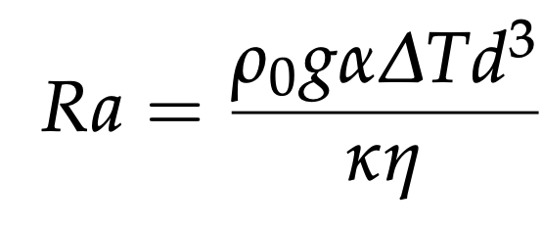
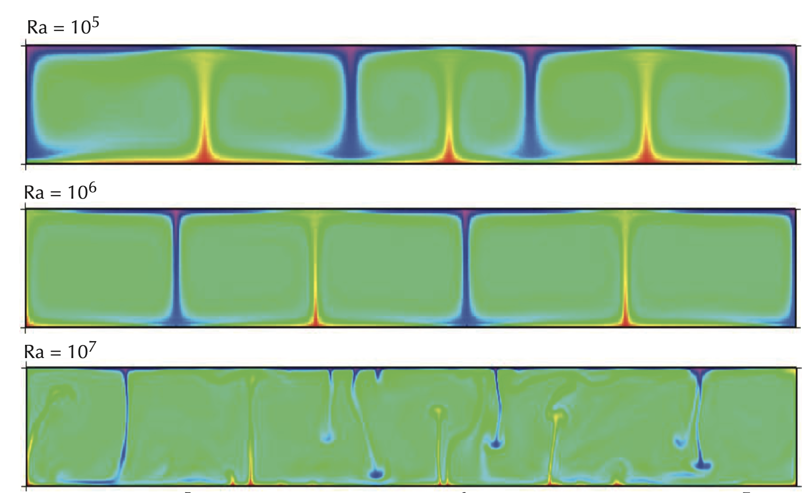
Recap: The Rayleigh Number
Increasing Ra # increases the convective vigor and decreases the relative importance of conduction. Also scales with the Nusselt #.
Becker and Faccenna, Tectonic Geodynamics

Slide 4
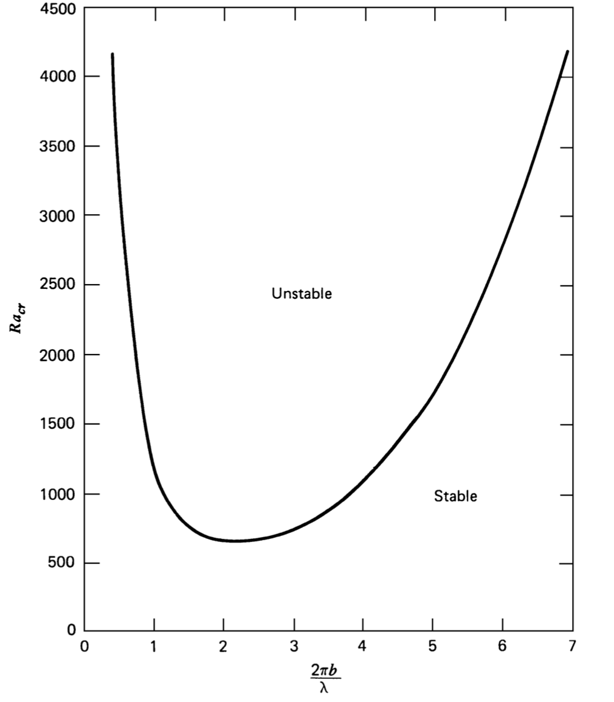
At what Rayleigh number does thermal convection begin?
Critical Rayleigh number
Aspect ratio

Slide 5

To the stylus…
When does thermal convection begin?
Linear stability analysis for onset of convection

Slide 6
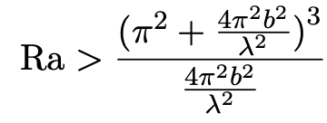
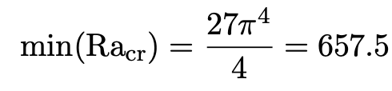
Onset of convection: Main result
Rayleigh-Bernard convection if:
= Ra_{cr}
Turcotte and Schubert

Slide 7
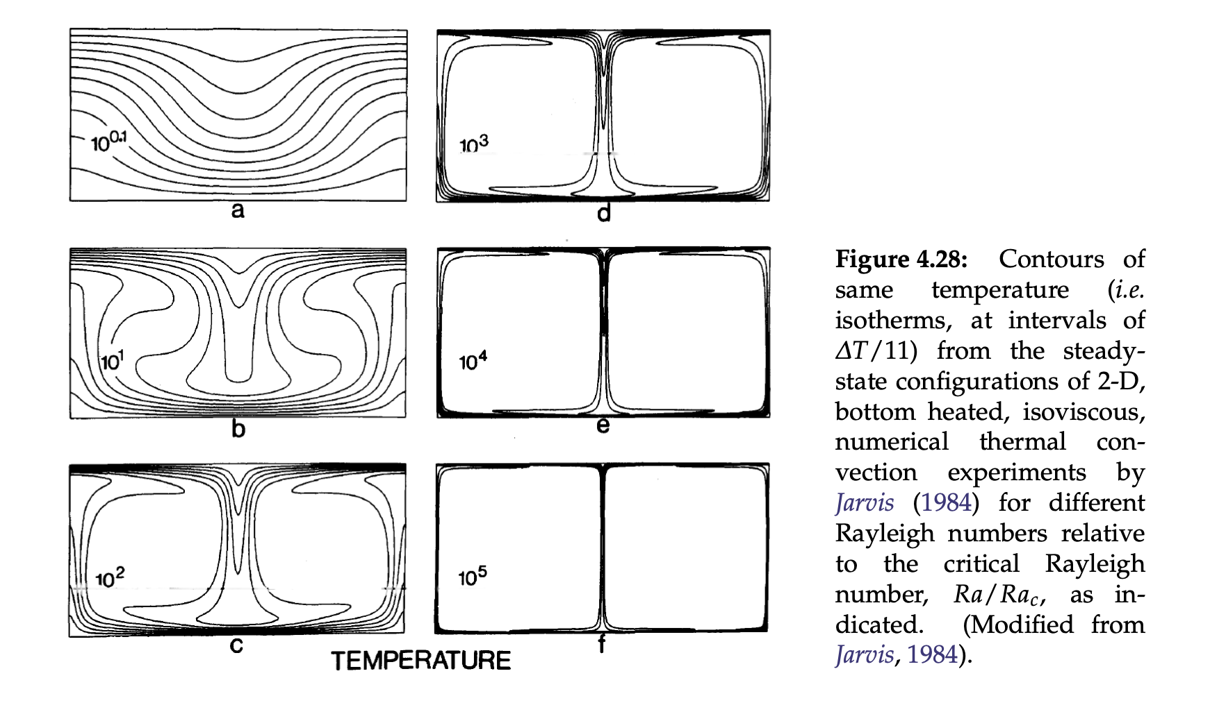
Onset of convection
1.25
Becker and Faccenna

Slide 8
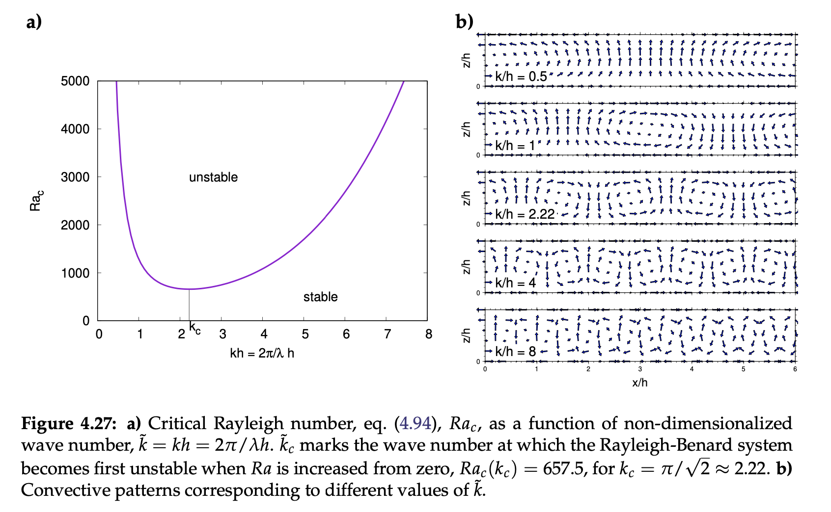
Onset of convection
Becker and Faccenna

Slide 9
Onset of convection
Becker and Faccenna

Slide 10
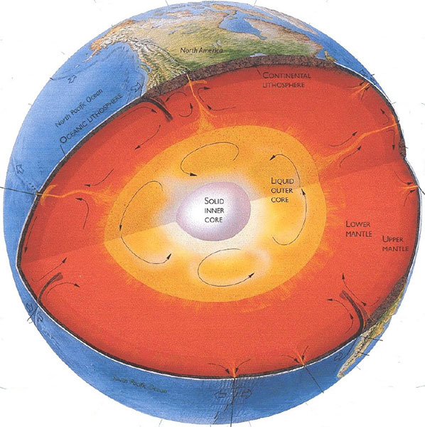

Convection on Earth
$$Ra≫{Ra}_{crit}$$
Mulyukova and Bercovici, 2020

Slide 11
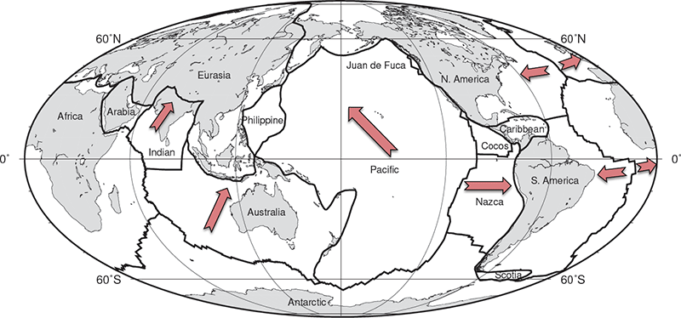
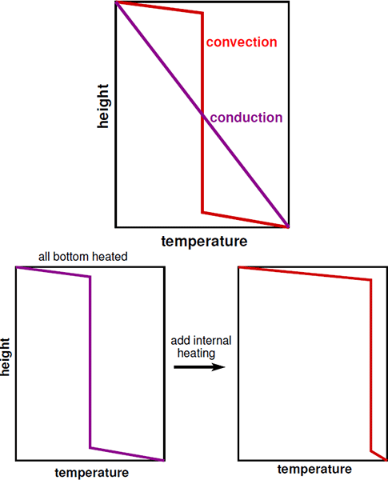
Convection on Earth
$$Ra≫{Ra}_{crit}$$
Tectonic plates constitute the cold thermal boundary layer of the convective mantle system (i.e., the conductively cooled surface layer). Plate tectonics is the surface manifestation of mantle convection.
Mulyukova and Bercovici, 2020

Slide 12
Convection on Earth
$$Ra≫{Ra}_{crit}$$
Note: Convective mixing homogenizes the mean temperature into a nearly isothermal state (if the fluid is incompressible)
Mulyukova and Bercovici, 2020

Slide 13
Convection on Earth
$$Ra≫{Ra}_{crit}$$
With no internal heating the interior mean temperature is the average of the top and bottom; adding internal heating increases the interior mean temperature and changes the relative temperature drops across the two thermal boundary layers.

Slide 14
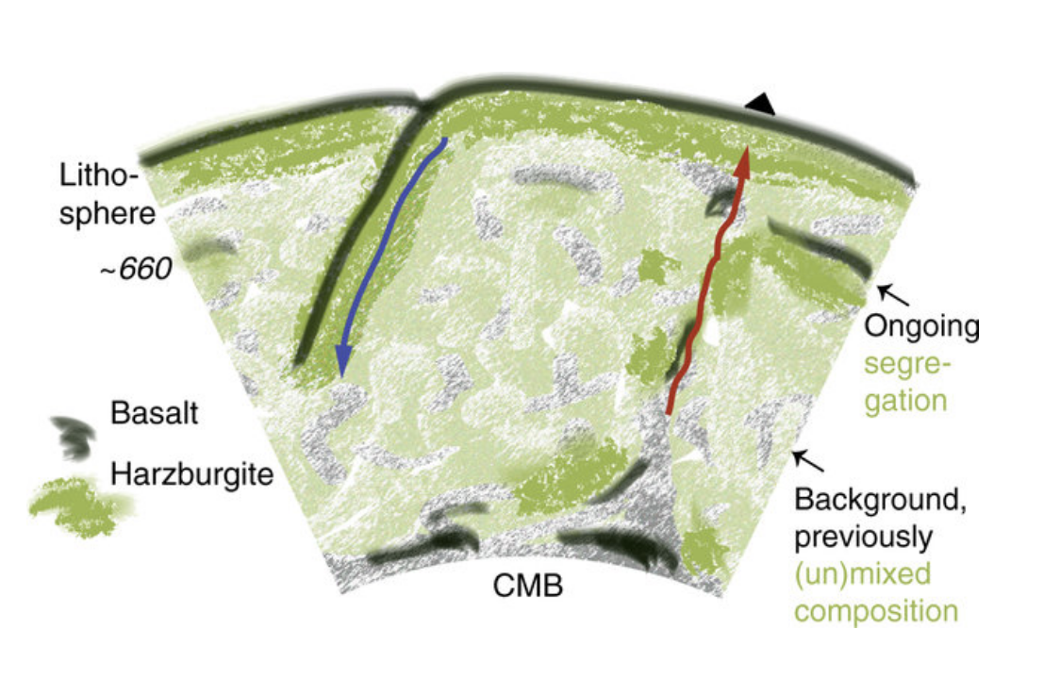
Convection on Earth
A thermo-chemical component...
Yu et al., 2018

Slide 15
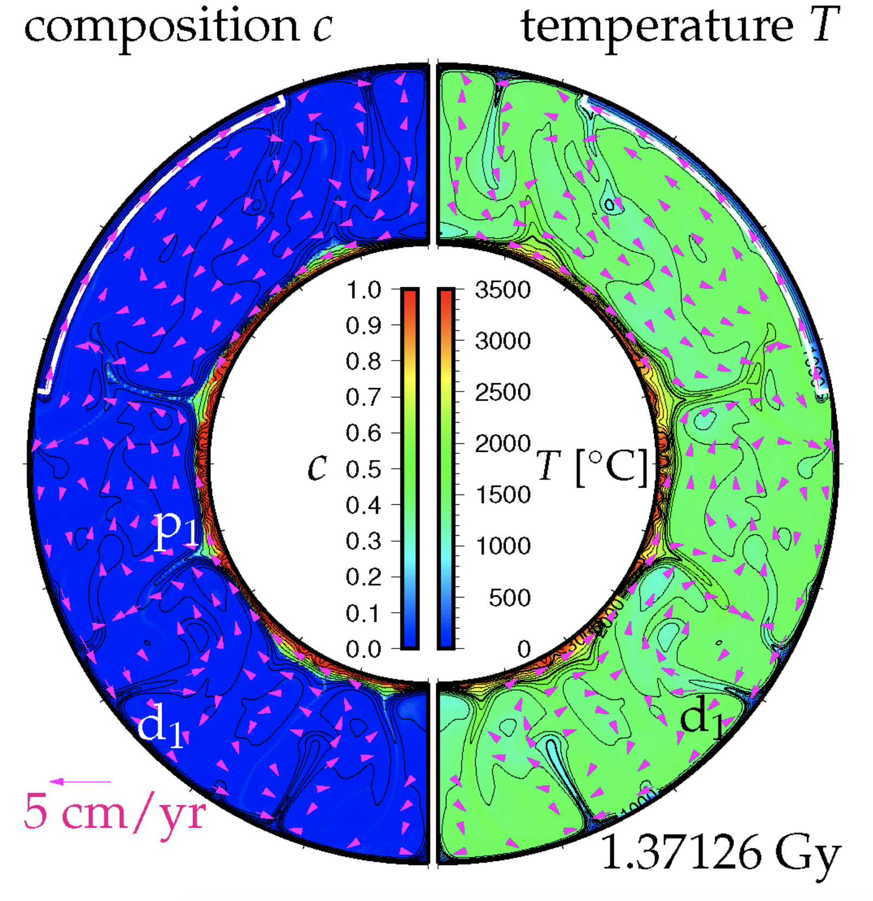
Convection on Earth
A thermo-chemical component...
Yu et al., 2018
LLSVPs (large low-shear-velocity provinces): chemically denser (and hot)
Kameyama and Harada, 2017

Slide 16
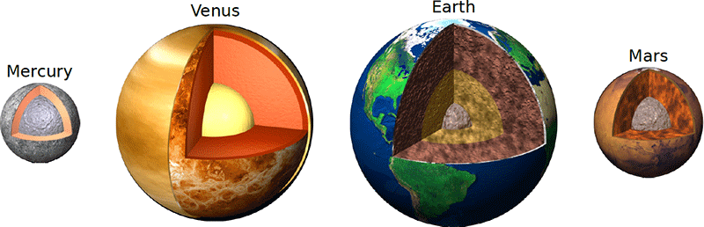
Convection on the other rocky terrestrial planets

Slide 17

Convection on the other rocky terrestrial planets
Check this out:

Slide 18
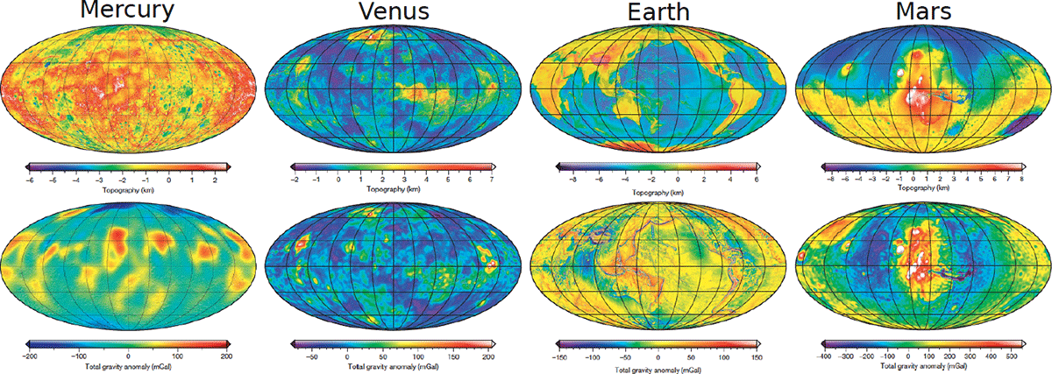
Convection on the other rocky terrestrial planets

Slide 19
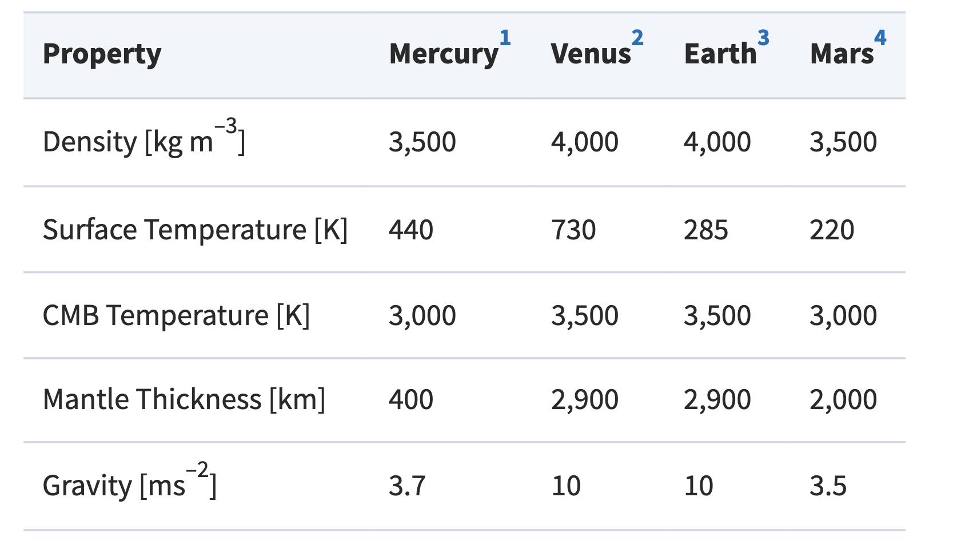
Convection on the other rocky terrestrial planets
Mulyukova and Bercovici, 2020

Slide 20
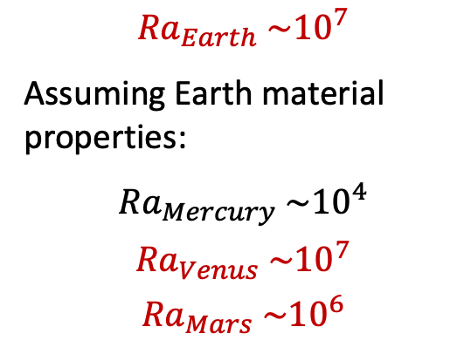
Convection on the other rocky terrestrial planets
$${Ra}_{Earth} \sim {10}^{7}$$
Assuming Earth material properties:
$${Ra}_{Mercury} \sim {10}^{4}$$
$${Ra}_{Venus} \sim {10}^{7}$$
$${Ra}_{Mars} \sim {10}^{6}$$
CONVECTION DOMINANT!
Mulyukova and Bercovici, 2020

Slide 21
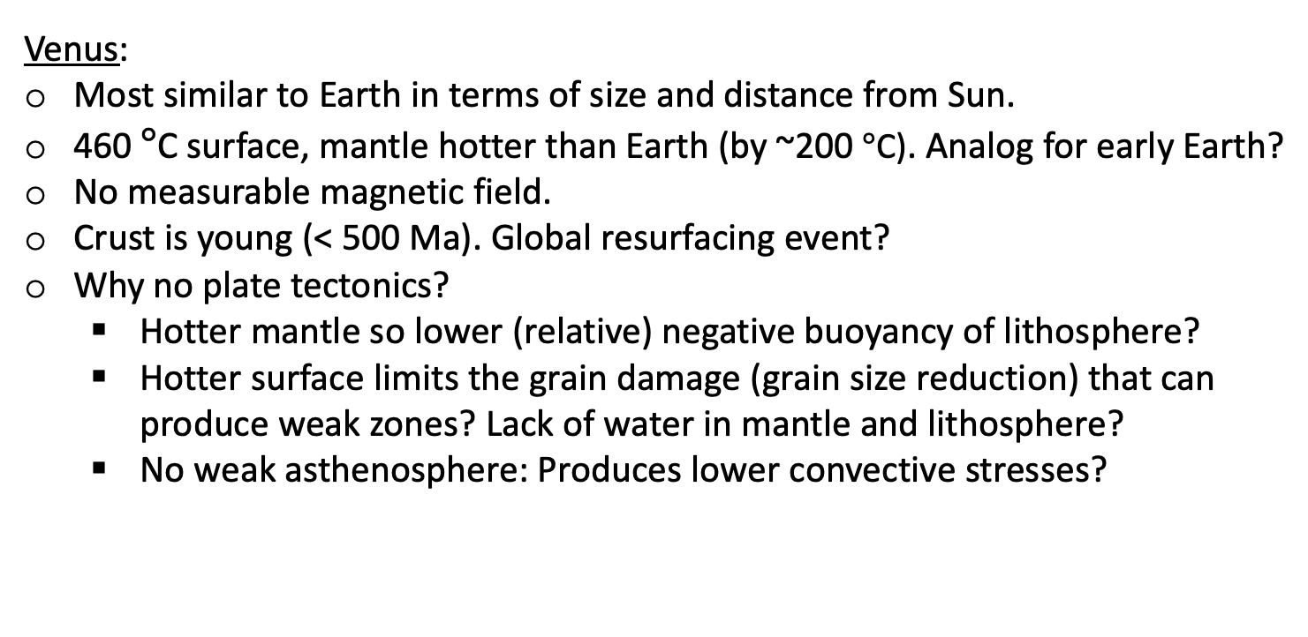
Convection on the other rocky terrestrial planets
Venus:
Most similar to Earth in terms of size and distance from Sun.
460 $°$C surface, mantle hotter than Earth (by ~200 $°$C). Analog for early Earth?
No measurable magnetic field.
Crust is young (< 500 Ma). Global resurfacing event?
Why no plate tectonics?
Hotter mantle so lower (relative) negative buoyancy of lithosphere?
Hotter surface limits the grain damage (grain size reduction) that can produce weak zones? Lack of water in mantle and lithosphere?
No weak asthenosphere: Produces lower convective stresses?

Slide 22
Convection on the other rocky terrestrial planets
x
x
Mars:
Significantly smaller than Earth and Venus, cools faster to space.
Most Martian crust likely formed in first few 100 Myrs after accretion, when convection was vigorous.
But, due to rapid cooling, Mars is thought to now have a colder and less active interior than Earth.
No magnetic field at present, but magnetized crust shows there was one in the past. Maps of magnetized crust show that Mars may have had plate tectonics early in its history.
Another interesting feature: The crustal dichotomy (thicker, younger crust in south)

Slide 23
Convection on the other rocky terrestrial planets
?
Stagnant lid convection!
On most terrestrial planets (i.e., all except Earth), mantle convection occurs beneath the surface; while the surface may get deformed and have volcanic lavas emplaced on top of it, it remains in place for periods much longer than the characteristic timescale of mantle overturn. This mode of convection is termed “stagnant lid convection,” with the lid being the portion of the TBL that does not participate in convective flow, and planets cooling in this mode are termed “one-plate planets.”

Slide 24
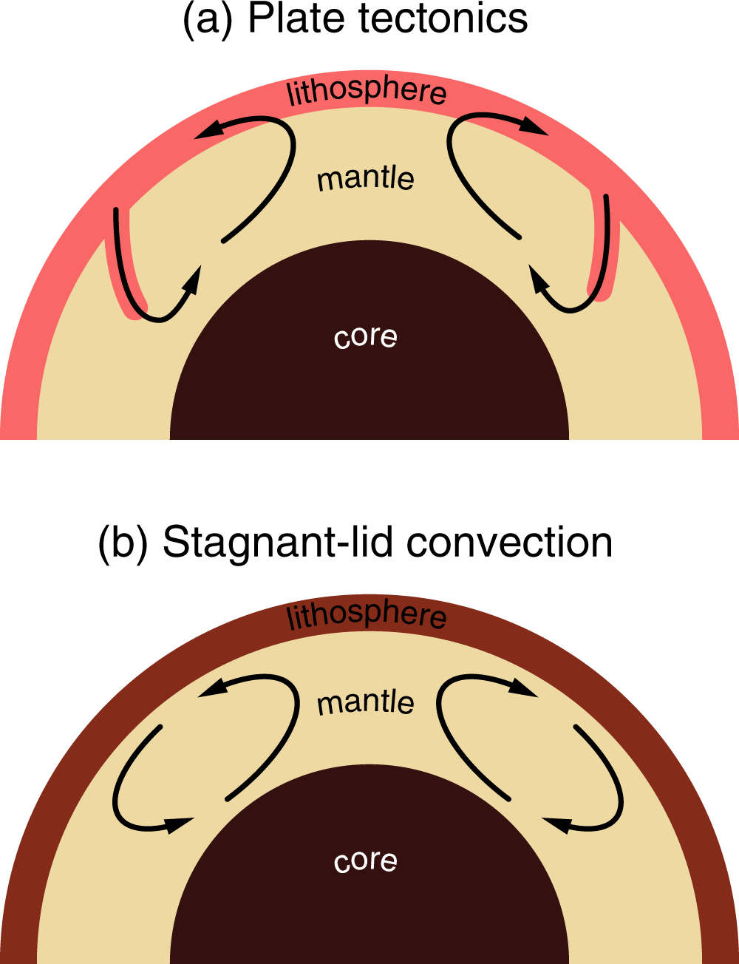
Karato and Barbot, 2018

Slide 25
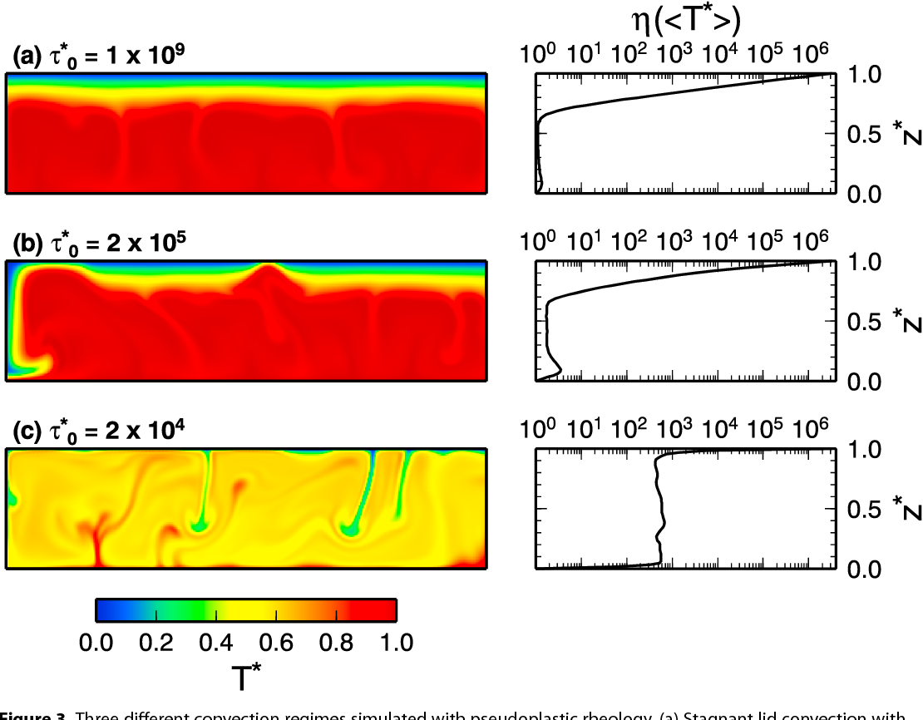
One to transition from stagnant to mobile: Reduce lithosphere strength
Korenaga, 2017

Slide 26
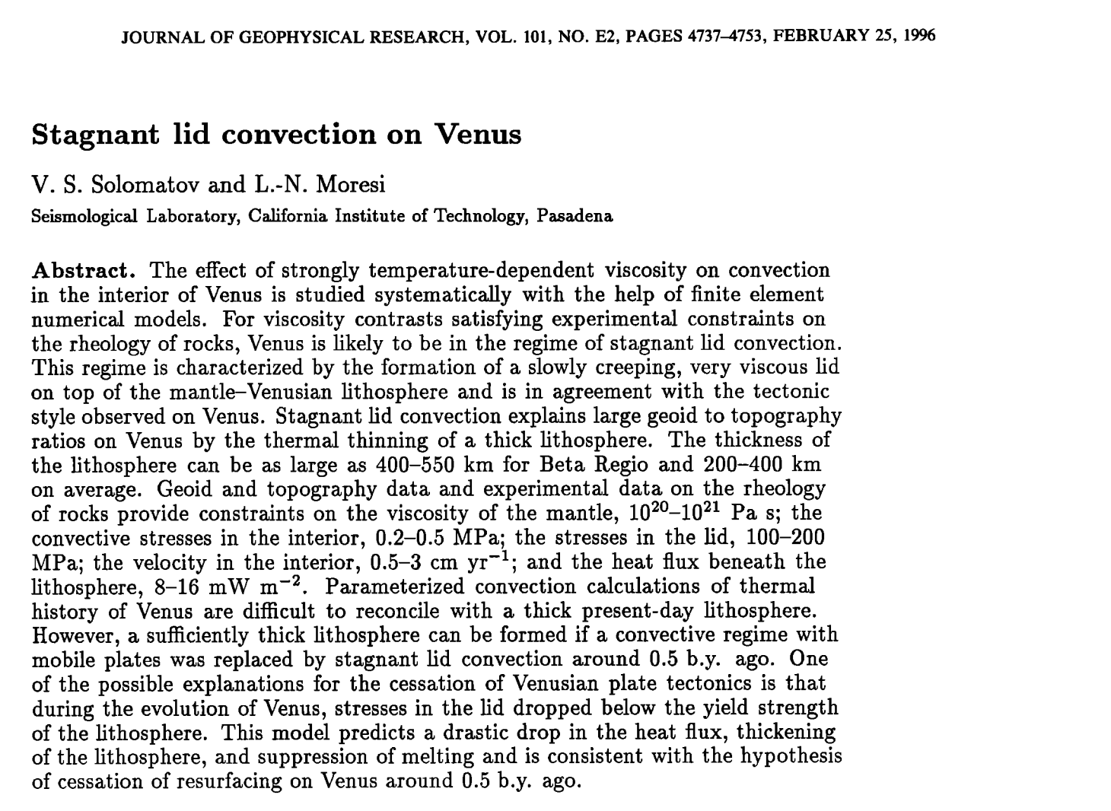
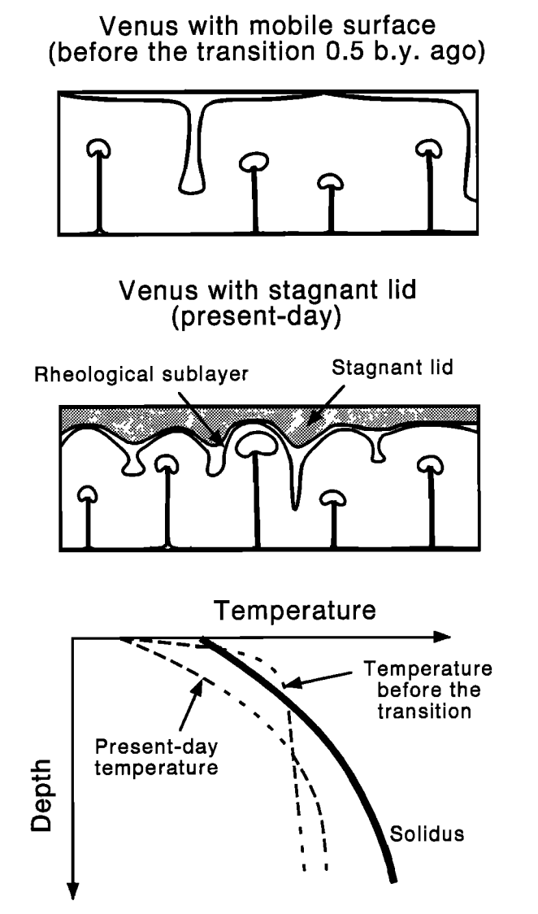

Slide 27

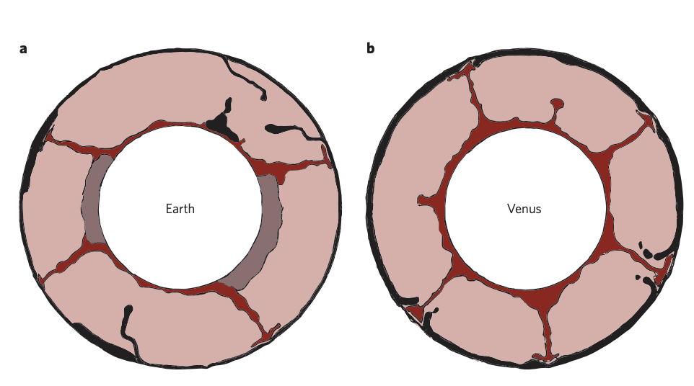
Recent speculation that Venus is in and intermediate mode:
Crameri, News and Views

Slide 28
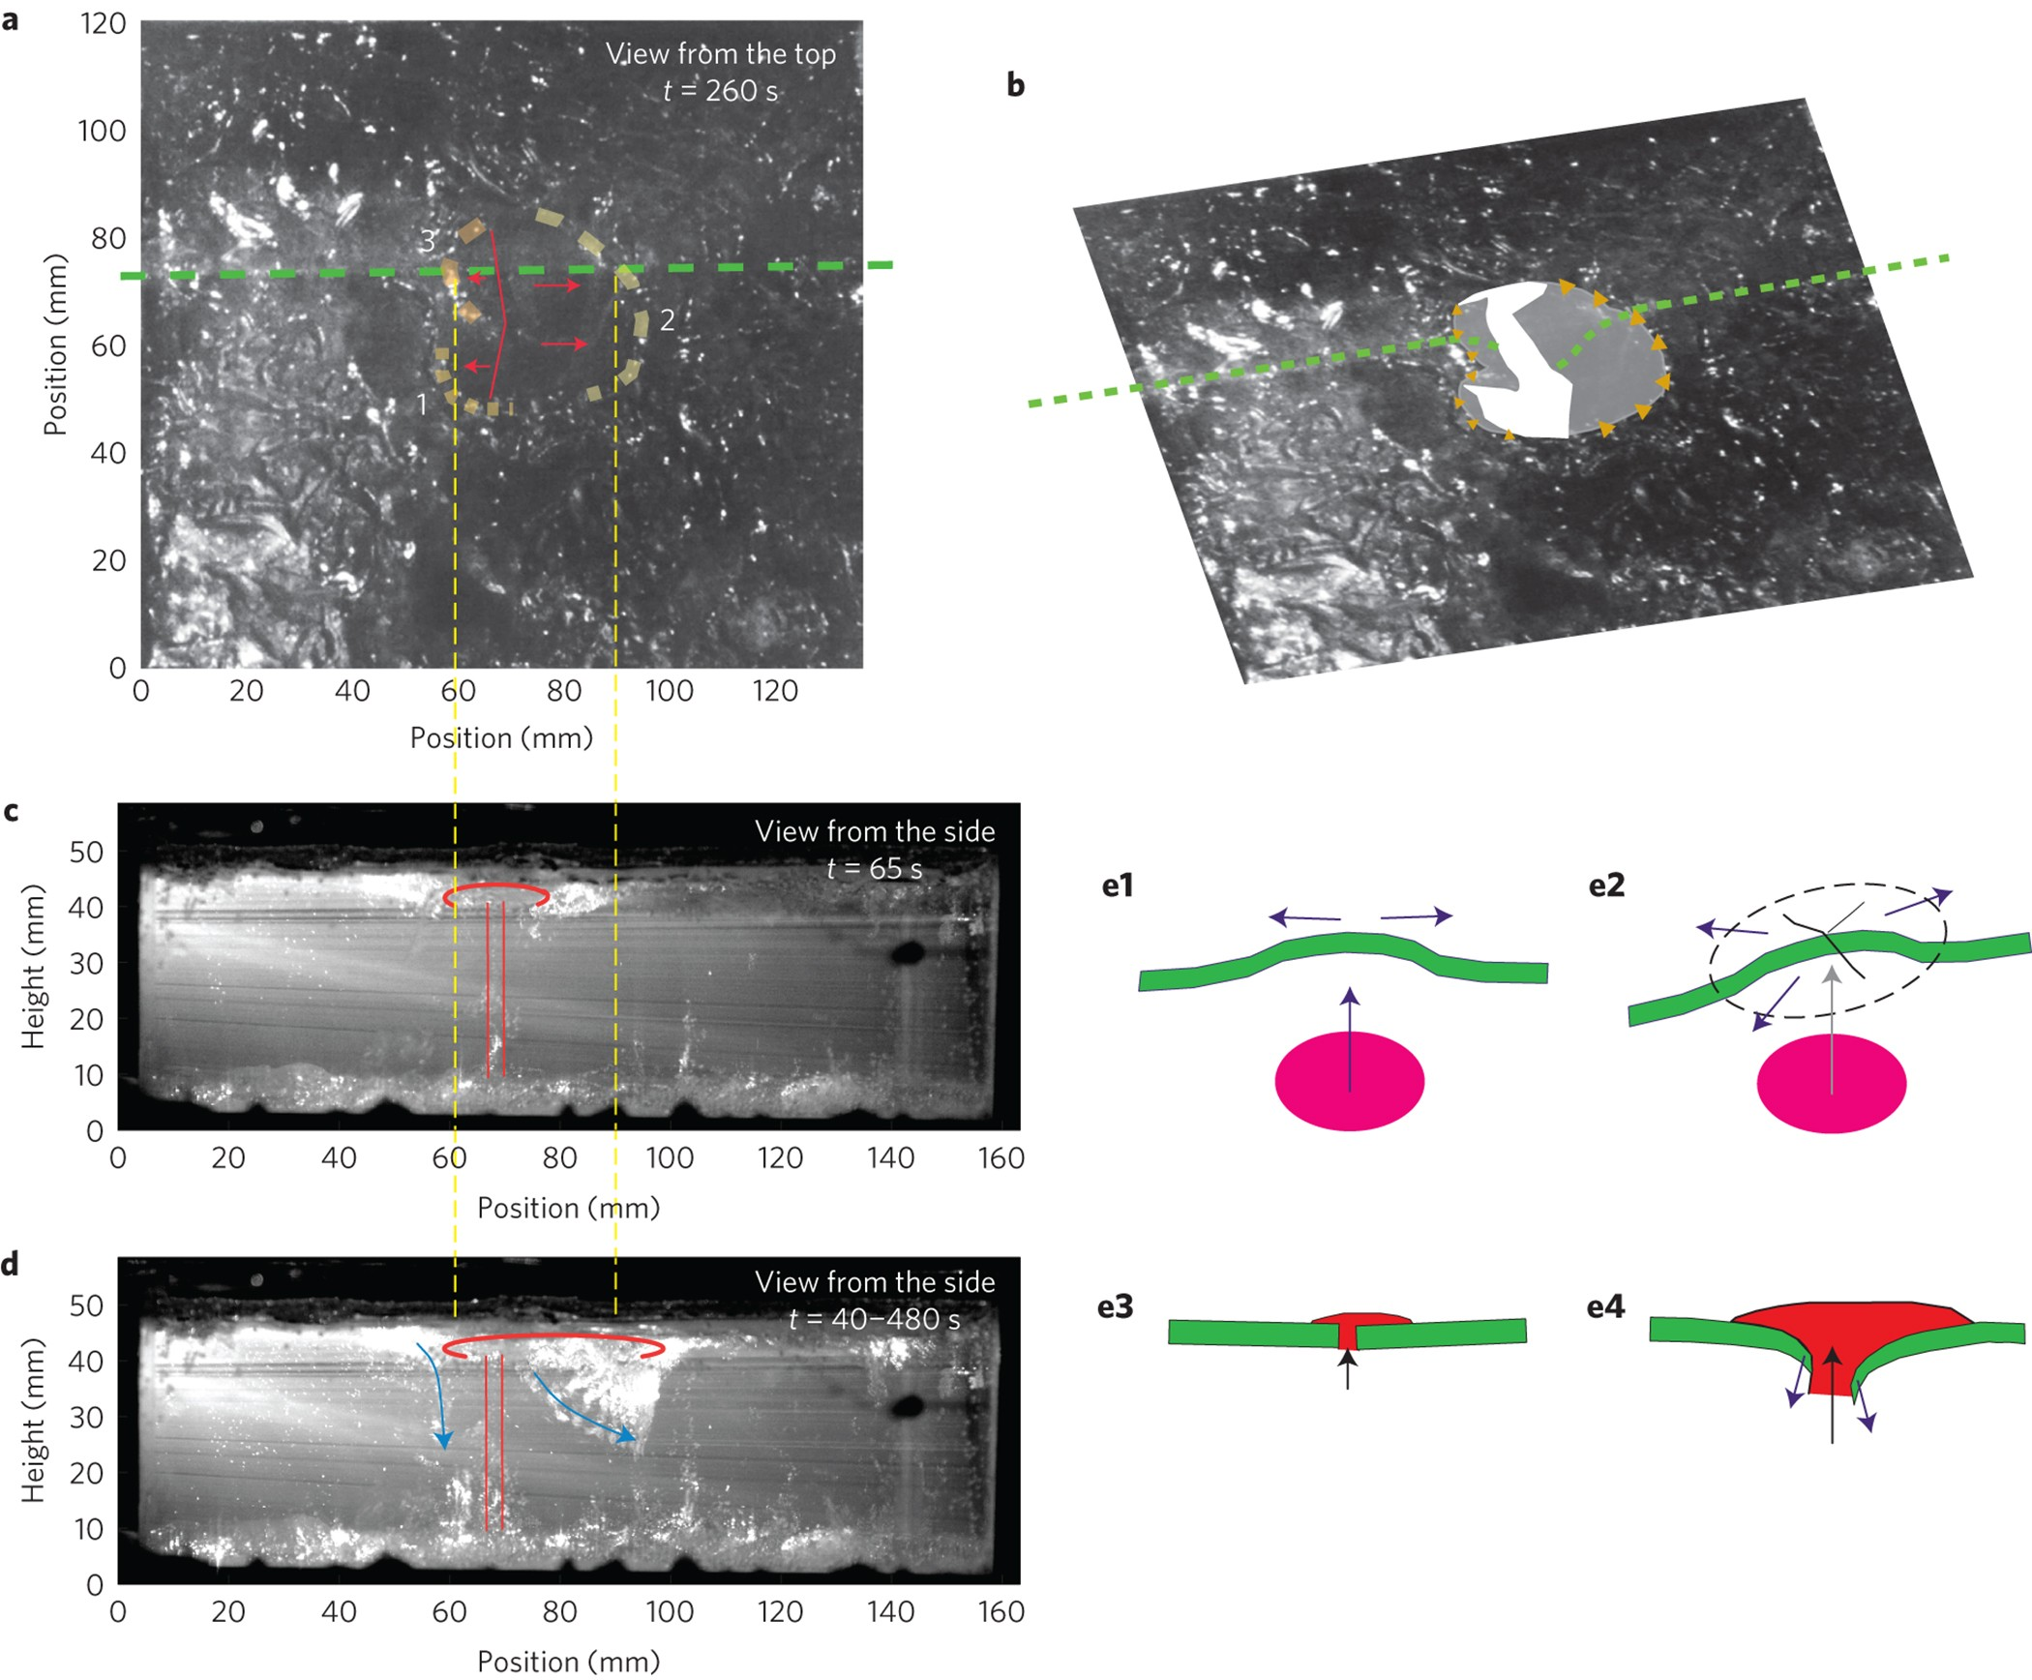
Davaille et al: Experiments

Slide 29
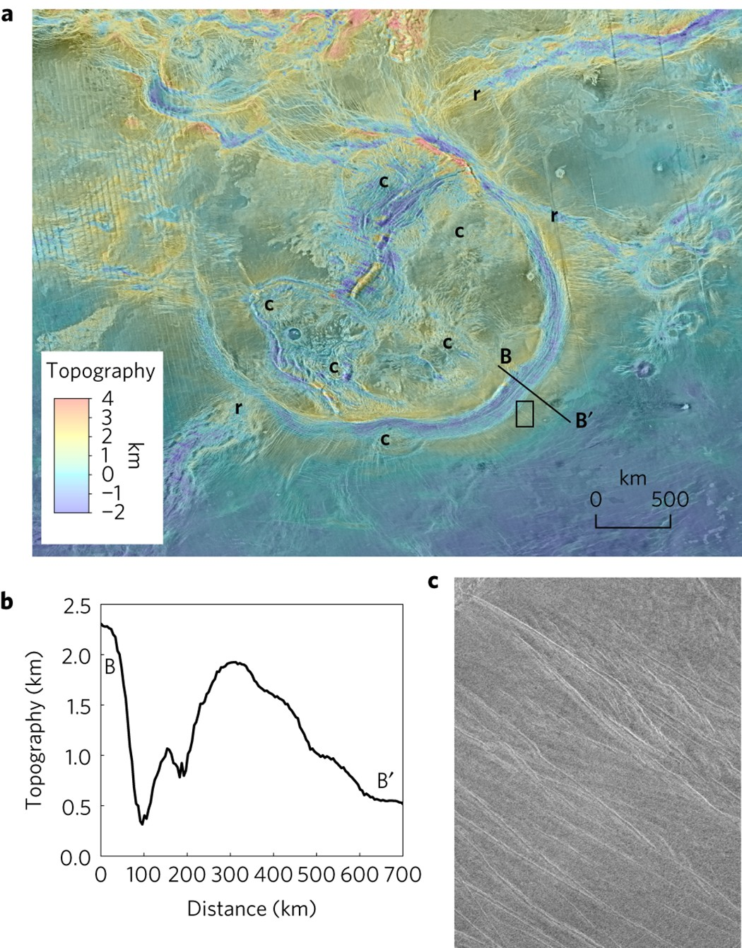
Davaille et al: Experiments
Davaille et al: Observations (Artemis Corona)

Slide 30
Take homes:
Onset of convection can be described with critical Rayleigh number (Ra_{crit}), as derived using linear stability analysis. Vigorous convection for Ra >> Ra_{crit}. Can also figure out optimal convective wavelength.
Plate tectonics is Earth’s surface expression of mantle convection (and tectonic plates are the outer thermal boundary layer).
Most other rocky (terrestrial) planets appear to be in a “stagnant lid” regime: Convection is occurring (i.e., Ra > Ra_{crit}) but the surface does not participate. Many potential reasons why.
A nice overview of convection on Earth and other planets (placed in the class Dropbox folder):

